Slide 1
SQL Case Study Simple Banking Application
This case study involves a simple banking application, covering customers, accounts, transactions, branches, account-branch assignments, and loans

Slide 2
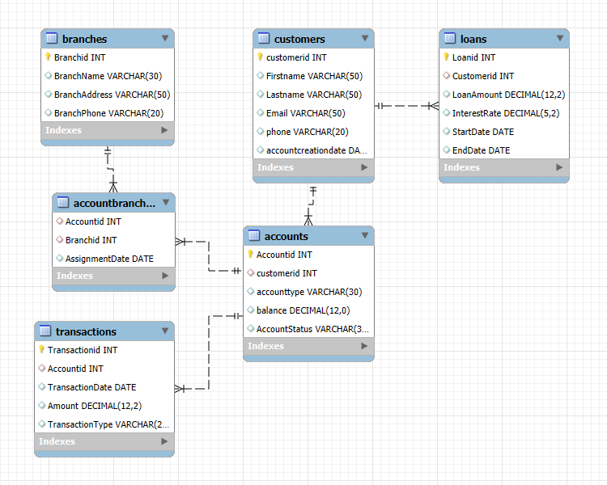
Database Schema
Customers To Accounts
Relationship: One to many
Customers To Loans
Relationship: One to Many
Accounts To Transactions
Relationship: One to Many
Accounts To AccountBranches
Relationship: One to Many
Branches To AccountBranches
Relationship: One To Many

Slide 3
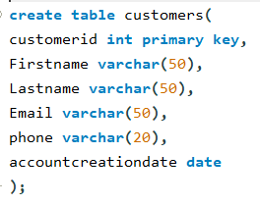
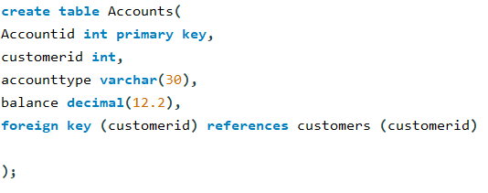
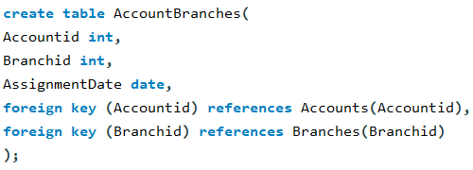
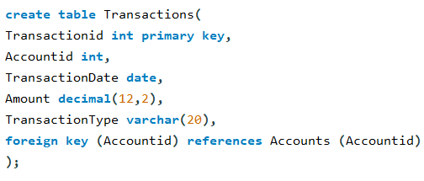
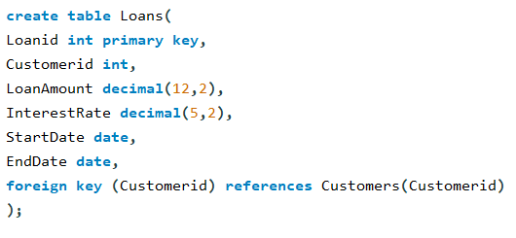
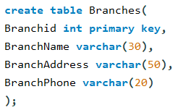
Database Table Design Create all the tables with the specified columns and foreign key references

Slide 4
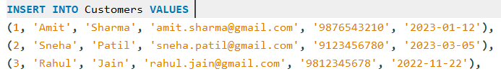

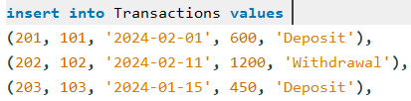

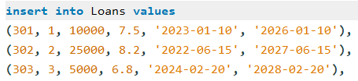

Data Insertion Insert at least 10 records into each table to populate the database with sample data
Customers
Accounts
Transactions
AccountBranches
Loans
Branches

Slide 5
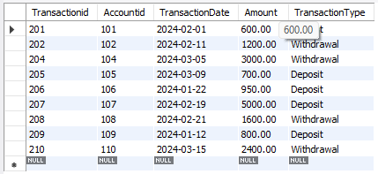
High Value Transactions Select all transactions from the Transactions table where the Amount is greater than $500
Filters the `Transactions` table using a simple `WHERE` clause.
Identifies transactions that exceed $500.

Slide 6
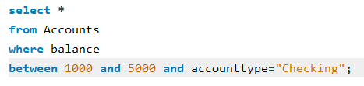
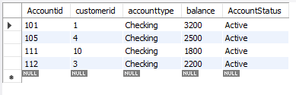
Conditional Filtering Select all Accounts where the Balance is between $1000 and $5000 and the AccountType is 'Checking'
Demonstrates combined filtering using `BETWEEN` and `AND` operators.
Precisely targets 'Checking' accounts within a specific balance range ($1k - $5k).

Slide 7

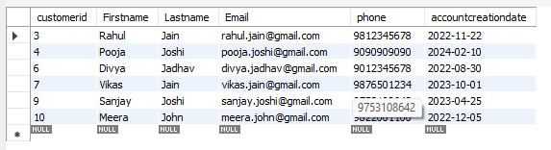
Pattern Matching Select all Customers whose LastName starts with 'J'
Uses LIKE for pattern matching.
'J%' means names beginning with letter J.
Useful for searching text-based data.

Slide 8
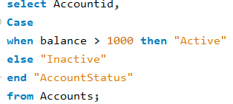
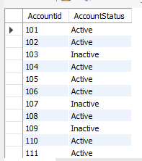
Data Transformation Select AccountID and a new column AccountStatus from the Accounts table. If Balance is greater than $1000, set AccountStatus to 'Active', otherwise 'Inactive'
Adds a new computed column (AccountStatus).
Classifies accounts as Active or Inactive based on balance.

Slide 9
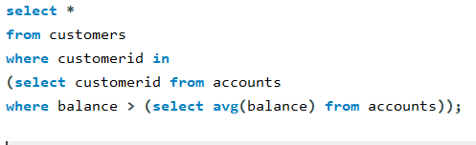

Subquery Analysis Find all Customers who have a balance in their accounts greater than the average balance of all accounts
Uses a subquery to calculate the average balance.
Filters customers whose account balance is above that average.

Slide 10


Aggregation Get the total Balance for each AccountType
Uses GROUP BY to group based on AccountType.
Uses SUM() to calculate total balance of each type.

Slide 11
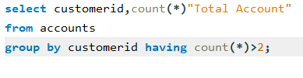

Filtering Groups Get the total number of accounts for each Customer, but only include customers who have more than 2 accounts
Uses COUNT() to count accounts per customer.
Uses HAVING (not WHERE) because condition applies after grouping.

Slide 12
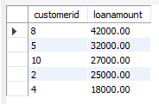

Ranking Data Select the top 5 customers with the highest LoanAmount
Uses ORDER BY DESC to sort high to low.
Uses LIMIT to fetch only top 5 records.

Slide 13
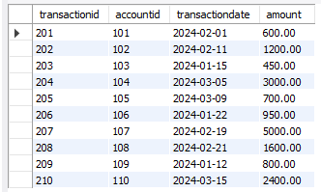

Inner Join Join Transactions with Accounts to get a list of all transactions with AccountID, TransactionDate, and Amount
Connects related tables using INNER JOIN.
Shows only accounts that have transactions.

Slide 14

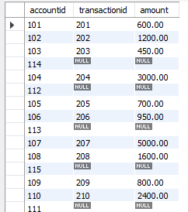
Outer Join Get a list of all Accounts and any associated Transactions. Include accounts that might not have any transactions.
Uses LEFT JOIN to include accounts even if they have no transactions.
Helps detect inactive or new accounts.

Slide 15

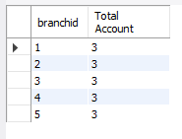
Branch Analytics Get the total number of accounts for each branch
Uses JOIN + GROUP BY.
Counts how many accounts belong to each branch.

Slide 16
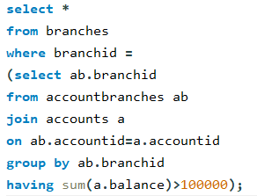

High Value Branches find all Branches that manage accounts with a total balance of more than $100,000
Uses subquery + HAVING SUM().
Finds only branches with high-value managed accounts.

Slide 17
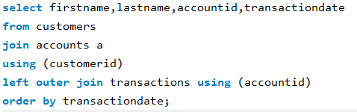
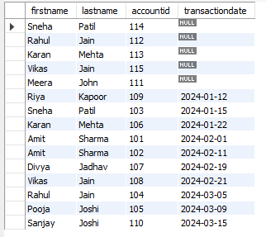
Full Customer View List FirstName, LastName, AccountID, and TransactionDate for all transactions
Uses INNER JOIN + LEFT JOIN.
Combines customer, account, and transaction data.
Retrieves complete banking activity history.

Slide 18
Thank You

